Slide 1
14th Annual Federal Policy Forum on Inclusion
#PolicyForInclusion
Accessibility
Summary

Slide 2
Housekeeping & Accessibility
This event will be presented in English and French.
We are pleased to provide:
French and English simultaneous interpretation
ASL and LSQ
English and French CART captioning
The event agenda is available here: https://inclusioncanada.ca/2023/10/11/14th-annual-federal-policy-forum-on-inclusion/

Slide 3
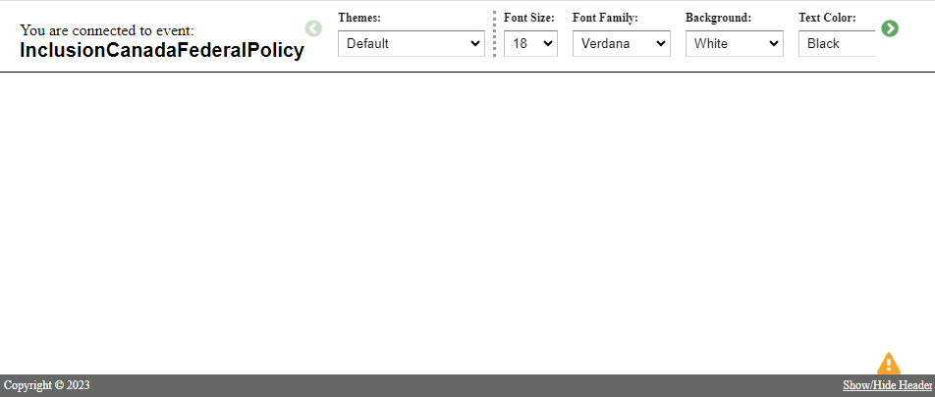
English or French CART captioning
To turn on English captions:
https://www.streamtext.net/text.aspx?event=InclusionCanadaFederalPolicy
To turn on French captions:
https://www.streamtext.net/text.aspx?event=InclusionCanadaFederalPolicyFRENCH
The CART captions will appear in a new window that looks like this:

Slide 4
CART captioning size, font & colour
Using the toolbar along the top of the window you can adjust:
the caption size
font style
text colour
background colour

Slide 5
French and English simultaneous interpretation
To turn on simultaneous interpretation:
Using the toolbar at the bottom of your screen, click the Interpretation button.
Choose your preferred language.
To remove the original audio, click the Interpretation button again and select, Mute original audio.

Slide 6
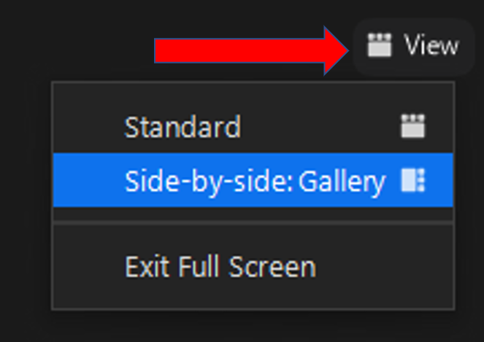
ASL and LSQ interpretation
ASL and LSQ interpreter videos will be labelled as ASL 1, LSQ 1.
To see the panelist who is speaking and the interpreter at the same time, use side-by-side gallery view.​
To set side-by-side view:
click on View in the upper right-hand corner of your screen
Click Side-by-side: Gallery.

Slide 7
Screen Layout
To adjust the screen layout:
Drag the slider left to make the speaker and interpreter videos bigger.
Drag the slider right to make the PowerPoint presentation bigger.
Slider

Slide 8
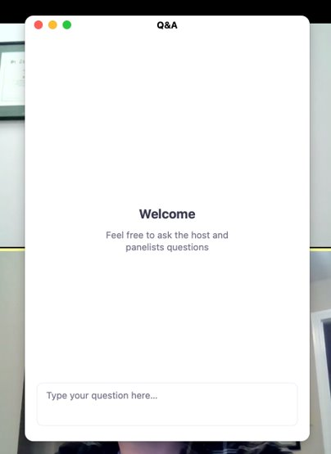
Question & Answer
You can send questions for panelists using the Q&A function.
Open this feature by clicking Q&A at the bottom of your screen. ​
The Q&A box can be moved by clicking and dragging it. Close the Q&A by clicking the red dot in the upper left-hand corner.
Questions can also be submitted by email to forum@inclusioncanada.ca

Slide 9
Technical Problems
If you have questions about technical problems, please email forum@inclusioncanada.ca
To avoid common problems:
Watch the webinar from a location with a strong internet connection
Check that your computer’s volume is turned on

Slide 10
Accessibility Summary
For any questions about accessibility accommodations please email forum@inclusioncanada.ca
*Please note that these accessibility features offer the best experience when used on a computer rather than a mobile device.

